Slide 1
Welcome, MCDB & MIMG Students!
Please open/bookmark our websites below for digital copies of our slides & resources if helpful to you:
www.mcdb.ucla.edu/new-student-orientation/
www.mimg.ucla.edu/education/undergraduate/
new-student-resources

Slide 2


New Student Orientation 2024
Maggie Schmall, Undergraduate Advisor, MCDB
Dr. Jenesis Fonseca, Undergraduate Advisor, MIMG
Sierra Dwyer, Undergraduate Advisor, MIMG

Slide 3
MCDB & MIMG New Student Orientation Resources
https://www.mcdb.ucla.edu/new-student-orientation/
https://mimg.ucla.edu/education/undergraduate/
new-student-resources
Bookmark if helpful!

Slide 4
MCDB (Molecular, Cell & Developmental Bio.) Advising Information
MCDB Advisor: Maggie Schmall
Email: undergradmcdb@lifesci.ucla.edu
Website: www.mcdb.ucla.edu

Slide 5
MIMG (Microbiology, Immunology, & Molecular Genetics) Advising Information
MIMG Advisors: Dr. Jenesis Fonseca & Sierra Dwyer
Email: undergrad@microbio.ucla.edu
Website: www.mimg.ucla.edu

Slide 6
MCDB Major Requirements
Five upper division core courses
Laboratory requirement
20 units of approved upper division electives

Slide 7
MCDB Major Requirements
Upper Division Core Requirements
CHEM 153A – Biochemistry: Introduction to Structure, Enzymes, and Metabolism
LIFESCI 107 – Genetics
MCDB 165A – Biology of Cells
MCDB 138 – Developmental Biology
MCDB 144 – Molecular Biology of Cellular Processes

Slide 8
MCDB Major Requirements
Laboratory Requirement (Choose One)
1. MCDB 104AL – Research Immersion Lab in Developmental Biology
2. MCDB 187AL – Research Immersion Lab in Genomic Biology
3. MCDB 150AL – Research Immersion Lab in Plant-Microbe Ecology
4. MCDB 196B – Research Apprenticeship II + MCDB 180B – Scientific Analysis & Communication II
5. MCDB 198C – Honors Research in MCDB Limited to students completing the Biomedical Research Minor
6. MCDB 196B, 198B/C, 199B/C + MCDB 145 – Appreciation & Critical Review of Biomedical Research

Slide 9
MCDB Major Requirements
20 Units of Approved Upper Division Electives
Category 1 | 5 units from Category 1
Category 2 | 5 units from Category 1 or 2
Category 3 | 10 units of Category 1, 2, or 3

Slide 10
MIMG Major Requirements
Five upper division Foundation courses
Lab courses
Two focus electives
General elective (4 units)

Slide 11
MIMG Major Requirements
Upper Division Foundation Courses
CHEM 153A – Biochemistry: Introduction to Structure, Enzymes, and Metabolism
CHEM 153B – Biochemistry: DNA, RNA, and Protein Synthesis or MIMG 132 – Cell Biology of Nucleus
LIFESCI 107 – Genetics
MIMG 101 – Introductory Microbiology
MIMG C185A – Immunology

Slide 12
MIMG Major Requirements
Lab Courses
Path I | Path II
MIMG 103AL – Research Immersion Lab in Virology + | MIMG 196A – Research Apprenticeship I + MIMG 180A – Scientific Analysis & Communication I
MIMG 103BL – Advanced Research Analysis in Virology | MIMG 196B – Research Apprenticeship II + MIMG 180B – Scientific Analysis & Communication II

Slide 13
MIMG Major Requirements
Focus Electives (Choose Two)
CHEM 153A, 153B, 153L MCDB 138, 165A MIMG 102, 105, 132, CM156, 158, 168

Slide 14
MIMG Major Requirements
General Electives (Complete 4 Units)
MIMG Focus Electives MIMG C122 and/or 185B, 191H, 198, 199 Other Department-Approved Courses

Slide 15
60 Units of Upper Division Coursework
MCDB consists of about 49 UD units
MIMG consists of about 43 UD units
You must take additional UD courses outside of the major
  Any course numbered 100-199
  Minor

Slide 16
Getting Involved in Research
Biomedical Research Minor
  Introductory course required to apply - BMD RES 5HA, BMD RES 10H, HNRS 70A
Undergraduate Research Center
Consult with your MCDB or MIMG advisor for major-specific information

Slide 17
Tips for New Students
The Quarter System
Course Load
Prerequisites and Sequence of Courses
When to Seek Advice
College vs. Departmental Advisors
Professors’ Office Hours
Current Contact Information

Slide 18
Medical School Requirements
3 quarters of college English (AP does not apply)
3 quarters of college math (AP does not apply) including Statistics
1 year of biology with lab (LIFESCI 7A, 7B, 7C, 7L)
CHEM 14 series or CHEM 20/30 series + CHEM 153A fulfills the chemistry with lab requirement (AP does not apply)
Physics is covered by the major
Spanish is highly recommended

Slide 19


Slide 20
Join Your Department’s Listserv
To subscribe to MCDB:
  Send an email to MCDBIO-L+subscribe@lists.ucla.edu
To subscribe to MIMG:
  Send an email to MIMG+subscribe@lists.ucla.edu

Slide 21
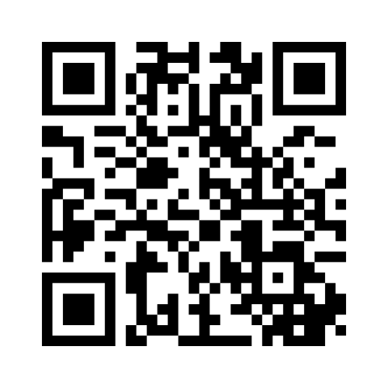
Q & A
Submit anonymous questions
via Mentimeter →
https://www.menti.com/ b l j z 3 j e 7 4 h h t

Slide 22
Additional Questions?
Send us an email!
undergradmcdb@lifesci.ucla.edu
undergrad@microbio.ucla.edu

Slide 23
Thank You

