Slide 1
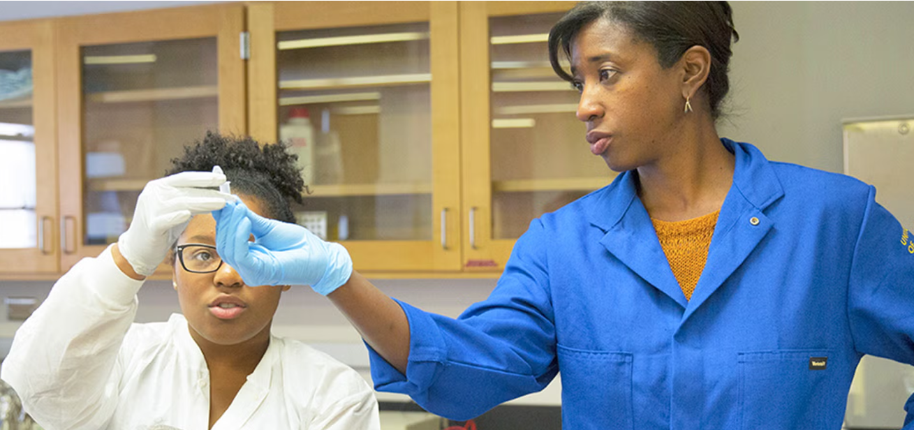
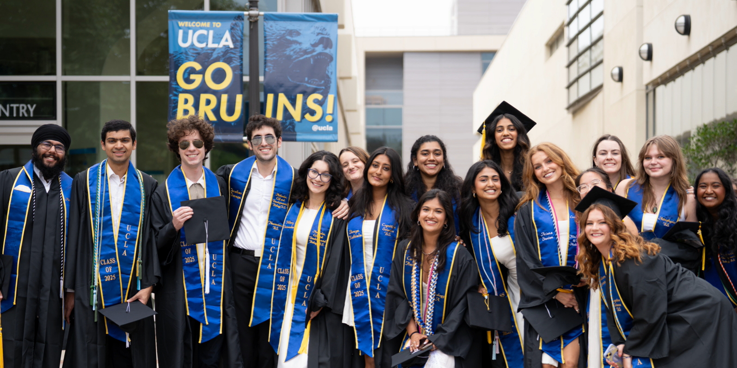
New Student Advisor Training
Molecular, Cell & Developmental Biology Major
Maggie Schmall and Jason Giron, Student Service Advisors

Slide 2
New Student Orientation Resources
Presentation slides will be posted on www.mcdb.ucla.edu/new-student-orientation/
Questions?
Email us at undergradmcdb@lifesci.ucla.edu
Call me at (310) 267-5908

Slide 3
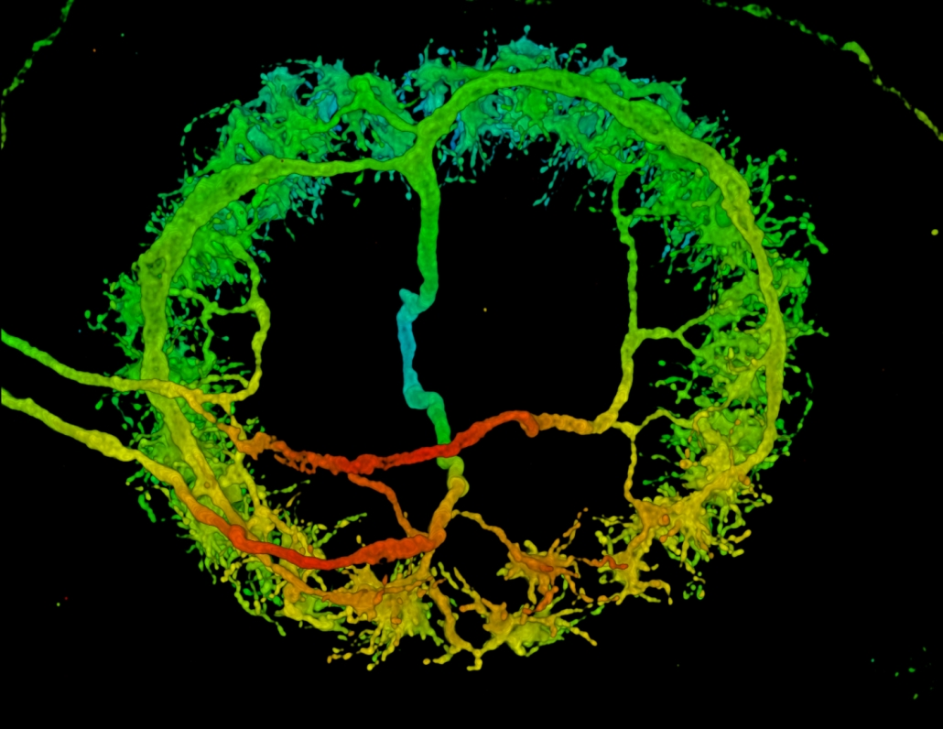
What do MCDB Majors Study?
MCDB is the study of life on earth at the cellular and molecular levels.
MCDB majors learn about molecular processes involved in cell function and differentiation, as well as the role of genes in multicellular organisms.
Students learn how to use the scientific method to test questions and solve problems, using quantitative and inquiry-related skills.

Slide 4
Life Science Core Education
Integrated Curriculum: Offers a cohesive course sequence designed for first-year undergraduates
Core Structure: Four foundational course series Life Sciences, plus Chemistry, Mathematics, and Physics
First Two Years: Makes up most of the coursework during your first two years as a life science major at UCLA
Interdisciplinary Teaching: Courses taught by faculty from diverse life science departments, exposing you to different disciplines
Common Foundation: All Life Science students take the same Core courses, preparing you for any life science major

Slide 5
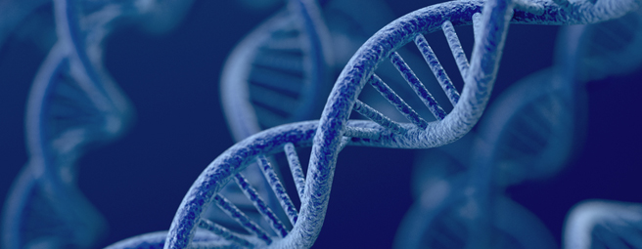
Life Science Core Curriculum
Life sciences
Chemistry
Mathematics
physics

Slide 6
Life Sciences Series: All Courses Required
Life Sciences Courses (# of Units)
LIFESCI 7A – Cell and Molecular Biology (5)
LIFESCI 7B – Genetics, Evolution & Ecology (5) Prerequisite: 7A
LIFESCI 7C – Physiology and Human Biology (5) Prerequisite: 7B
LIFESCI 7L – Intro to Laboratory and Scientific Methodology (3) Prerequisite: 7B

Slide 7
Chemistry Series (CHEM)
Life Science Series | OR | Physical Science Series
14A(E) – General Chemistry for Life Scientists I (Enhanced) (4) Co-requisite: LS 30A or MATH 3A or 31A, or place into MATH 3A/31A by taking the Math Diagnostic Test |  | 20A(H) - Chemical Structure (4) (Honors) Prep: Min 1 yr high school (HS) chemistry, 3.5 yrs HS math, (recommended) HS physics Co-req: MATH 31A
14B(E) - General Chemistry for Life Scientists II (Enhanced) (4) Prerequisite: CHEM 14A(E) or 20A (grade of C- or better; Co-Req: LS 30B or MATH 3B or 31B (grade of C- or better) |  | 20B(H) - Chemical Energetics and Change (Honors) (4) Prerequisites: CHEM 20A(H) and MATH 31A (grades of C- or better)
14BL - General and Organic Chemistry Lab I (3) Prereq: CHEM 14A or 20A(H) (grade C- or better) Pre- or Co-requisite: CHEM 14B |  | 20L - General Chemistry Laboratory (3) Prerequisite: CHEM 14A or 20A (grade of C- or better) Pre- or Co-requisite: CHEM 14B or 20B
14C – Structure of Organic Molecule (4) Prerequisite: CHEM 14B (grade of C- or better) |  | 30A – Organic Chemistry I: Structure & Reactivity (4) Prerequisite: CHEM 20B
14D – Organic Reactions & Pharmaceuticals (4) Prerequisite: CHEM 14C (grade of C- or better) |  | 30AL - General Chemistry Laboratory II (4) Prerequisites: CHEM 20B(H), 20L, 30A(H) (grades of C- or better)
 |  | 30B – Organic Chem II: Reactivity, Synthesis, & Spectroscopy (4) Prerequisite: CHEM 30A (grade of C- or better)

Slide 8
Chemistry Series (CHEM) continued…
ADDITIONAL Chemistry (Not Required for the Major)
These courses are recommended for students planning to attend professional schools.
Life Science Series |  | Physical Science Series
14CL - General & Organic Chemistry Lab II (4) Prerequisites: CHEM 14B, 14BL or 20B, 20L (grades of C- or better) Pre- or Co-requisite: CHEM 14C |  | 30BL - Organic Chemistry Laboratory I (3) Prerequisites: CHEM 30A(H), 30AL, 30B (grades C- or better)
 |  | 30C - Organic Chemistry III: Reactivity and Synthesis, and Biomolecules (4) Prerequisite: CHEM 30B (grade C- or better)
OR
IMPORTANT NOTE: After Completing CHEM 20A, students can move to the 14 Series starting with 14B, or after taking CHEM 20A, 20B, 20L may take CHEM 14C, 14CL, 14D. Students who wish to switch from the 14 series to the 20/30 series after taking CHEM 14A, 14B, and 14BL, can take CHEM 30A, 30AL, 30B.

Slide 9
Mathematics Series
Mathematics for Life Sciences *Recommended* (# of Units)
LIFESCI 30A – Mathematics for Life Scientists (4)
LIFESCI 30B - Mathematics for Life Scientists (4) Prerequisite: LS 30A
LIFESCI 40 – Statistics of Biological Systems (5) Prerequisite: LS 30A OR Stats 13 – Introduction to Statistical Methods for Life and Health Sciences (5)
Note: The math diagnostic test is NOT required to start this series.
OR…

Slide 10
Mathematics Series (continued)
Life Science Series | OR | Physical Science Series
MATH 3A – Calculus for Life Science Students (4) Preparation: 3.5 years of HS math (including trigonometry) Requisite: Math Diagnostic Test Score of 48 or better or Course 1 (grade of C- or better) |  | MATH 31A(H)(L) – Differential & Integral Calculus (Honors) (Laboratory) (4) Preparation: 3.5 years of HS math (Including coordinate geometry and trigonometry) Requisite: Successful completion of Math Diagnostic Test or Course 1 (grade of C- or better)
MATH 3B – Calculus for Life Science Students (4) Prerequisite: Math 3A or 31A (grade C- or better) |  | MATH 31B(H) – Integration & Infinite Series (Honors) (4) Prerequisite: MATH 31A (grade of C- or better)
MATH 3C – Ordinary Differential Equations with Linear Algebra for Life Science Students (4) Prerequisite: Math 3B or 31B (grade C- or better) |  | MATH 32A(H) – Calculus of Several Variables (Honors) (4) Prerequisite: MATH 31A (grade of C- or better)

Slide 11
Mathematics
NOTE: AP Calculus may give you credit for either 31A or 31A and 31B – see below.
Score | AB Exam | BC Exam
5 | Credit for MATH 31A → Enroll in Math 3B or 31B | Credit for MATH 31A, 31B → Enroll in Math 3C or 32A
4 | No credit for Math 3 or 31 series | Credit for Math 31A → Enroll in Math 3B or 31B

Slide 12
Math Diagnostic Test
Score | Placement
80% + | MATH 31A / MATH 3A
60 – 80% | MATH 31AL
30% + | MATH 1
Remember that the Math for Life Science series (LIFESCI 30A, 30B, STATS 13/LIFESCI 40) does not require the Math Diagnostic Test.

Slide 13
Physics
Life Science Series | OR | Physical Science Series
5A – Physics for Life Science Majors: Mechanics and Energy (5) Prerequisite: MATH 3A, 3B, 3C, or MATH 31A, 31B, 32A or LS 30A, 30B |  | 1A(H) - Physics for Scientists and Engineers: Mechanics (Honors) (5) Prerequisites: MATH 31A and 31B Pre- or Co-requisite: MATH 32A
5B – Physics for Life Science Majors: Thermodynamics, Fluids, Waves, Light and Optics (5) Prerequisite: PHYSICS 5A |  | 1B(H) - Physics for Scientists and Engineers: Oscillations, Waves, Electric and Magnetic Fields (Honors) (5) Prereq: PHYSICS 1A, MATH 31B, 32A Pre- or Co-requisite: MATH 32B
5C – Physics for Life Science Majors: Electricity, Magnetism, and Modern Physics (5) Prerequisite: PHYSICS 5A |  | 1C(H) - Physics for Scientists and Engineers: Electrodynamics, Optics, and Special Relativity (Honors) (5) Prereq: PHYSICS 1A, 1B, MATH 32A, 32B Pre- or Co-requisite: MATH 33A
Labs: Each course in the 5 series includes both lecture and laboratory. |  | Labs: 4AL - Physics Lab for Scientists and Engineers: Mechanics (2) Prerequisite: PHYSICS 1A(H) Co-Req: PHYSICS 1B(H) 4BL - Physics Lab for Scientists and Engineers: Electricity and Magnetism (2) Prerequisite: PHYSICS 1A(H), 1B(H) Co-Requisite: PHYSICS 1C

Slide 14
Fall Quarter Recommendations – First Years
Total Courseload:
2 major classes + 1 non-major class (ex: ENG COMP 3, GE)
No more than 2 major classes
Any combination of Life Science, Chemistry, and Math. Example:
CHEM 14A and LIFESCI 30A
LIFESCI 7A and LIFESCI 30A

Slide 15
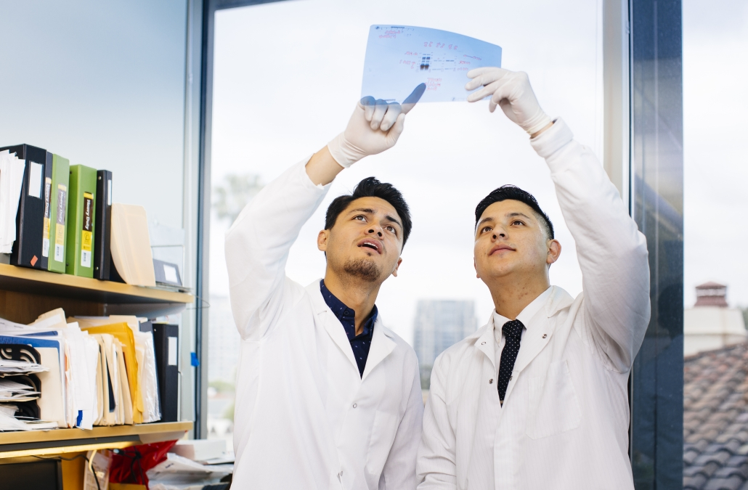
MCDB Major Requirements
Five upper division core courses
Laboratory requirement
20 units of approved upper-division electives

Slide 16
MCDB Major Requirements
Upper Division Core Requirements
CHEM 153A – Biochemistry: Introduction to Structure, Enzymes, and Metabolism
LIFESCI 107 – Genetics
MCDB 165A – Biology of Cells
MCDB 138 – Developmental Biology
MCDB 144 – Molecular Biology of Cellular Processes

Slide 17
MCDB Major Requirements
Laboratory Requirement (Choose One)
1. MCDB 104AL – Research Immersion Lab in Developmental Biology
2. MCDB 187AL – Research Immersion Lab in Genomic Biology
3. MCDB 150AL – Research Immersion Lab in Plant-Microbe Ecology
4. MCDB 196B – Research Apprenticeship II + MCDB 180B – Scientific Analysis & Communication II
5. MCDB 198C – Honors Research in MCDB Limited to students completing the Biomedical Research Minor
6. MCDB 196B, 198B/C, 199B/C + MCDB 145 – Appreciation & Critical Review of Biomedical Research

Slide 18
MCDB Major Requirements
20 Units of Approved Upper Division Electives
Category 1 | 5 units from Category 1
Category 2 | 5 units from Category 1 or 2
Category 3 | 10 units of Category 1, 2, or 3

Slide 19
Fall Quarter Recommendations – Transfers
Total Courseload:
2 major classes + 1 non-major elective
No more than 2 major classes
Pick 2:
CHEM 30B or CHEM 153A or MCD BIO 165A
PHYSICS 5A/5B/5C
LIFESCI 107

Slide 20
Thank You!

