Slide 1
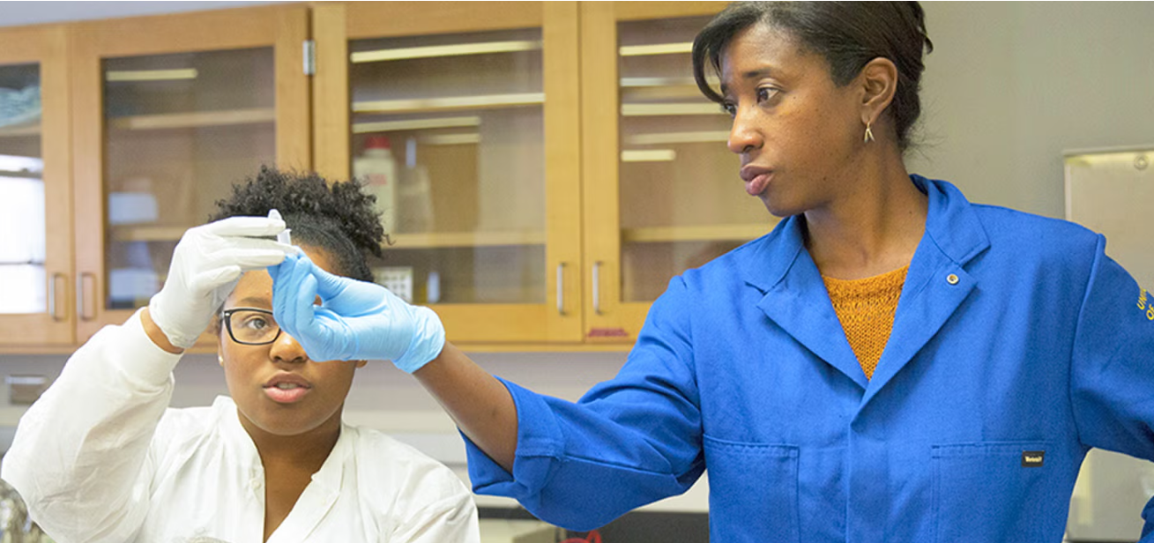
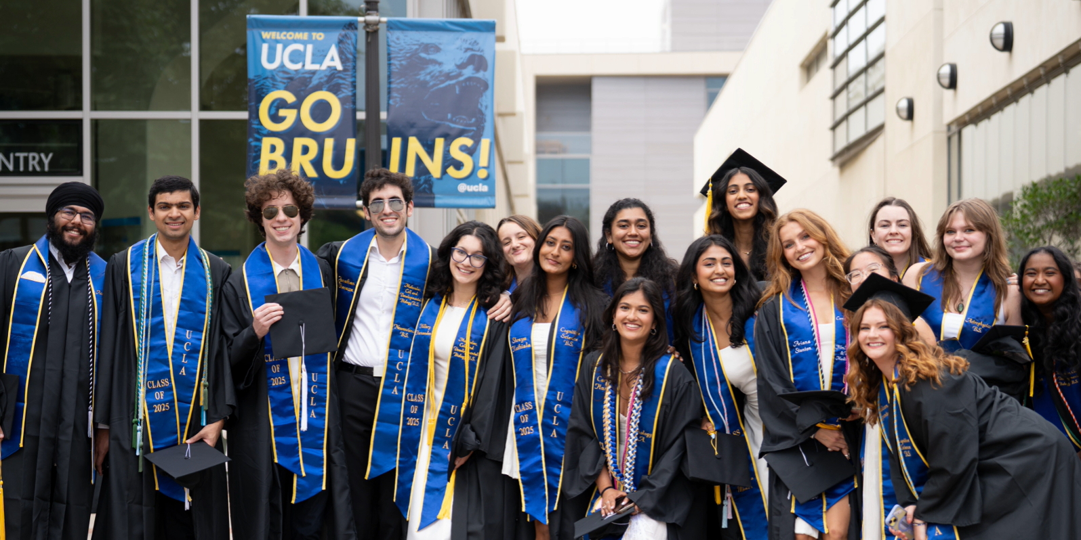
New Student Orientation 2025
Welcome, Bruins! We’re so glad you’re here!
Today’s Presenters: Advisor Name (Department), Advisor Name (Department)

Slide 2
Agenda
Life Sciences Core Curriculum (Major Preparation)
Pre-Health and Medical School Requirements
Undergraduate Research
Fall Course Recommendations
Time for Questions

Slide 3
Life Sciences (LS) Core Curriculum
First Two Years: Makes up most of the coursework during your first 2 years as a Life Sciences major at UCLA (approximately 2 Life Sciences Core courses per quarter.
Common Foundation:
Courses include Life Sciences, Chemistry, Math, and Physics.
Interdisciplinary Teaching: Courses taught by faculty from diverse life science departments, exposing you to different disciplines.

Slide 4
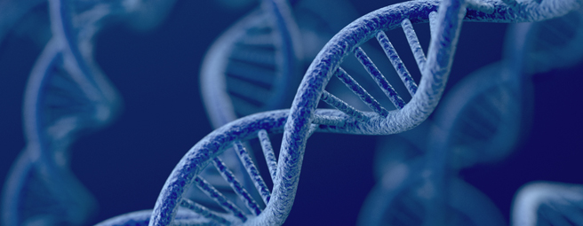
Life Sciences Core Curriculum
Series:
Life sciences
Chemistry
Mathematics
physics

Slide 5
Life Sciences Series: All Courses Required
Life Sciences Courses (# of Units)
LIFESCI 7A – Cell and Molecular Biology (5)
LIFESCI 7B – Genetics, Evolution & Ecology (5) Prerequisite: 7A
LIFESCI 7C – Physiology and Human Biology (5) Prerequisite: 7B
LIFESCI 7L – Intro to Laboratory and Scientific Methodology (3) Prerequisite: 7B
Notes:
*LS 7L not required for Computational Biology(Formerly known as Computational and Systems Biology)

Slide 6
Chemistry Series (CHEM)
Life Science Series | OR | Physical Science Series
14A(E) – General Chemistry for Life Scientists I (Enhanced) (4) Co-requisite: LS 30A or MATH 3A or 31A, or place into MATH 3A/31A by taking the Math Diagnostic Test |  | 20A(H) - Chemical Structure (4) (Honors) Prep: Min 1 yr high school (HS) chemistry, 3.5 yrs HS math, (recommended) HS physics Co-req: MATH 31A
14B(E) - General Chemistry for Life Scientists II (Enhanced) (4) Prerequisite: CHEM 14A(E) or 20A (grade of C- or better; Co-Req: LS 30B or MATH 3B or 31B (grade of C- or better) |  | 20B(H) - Chemical Energetics and Change (Honors) (4) Prerequisites: CHEM 20A(H) and MATH 31A (grades of C- or better)
14BL - General and Organic Chemistry Lab I (3) Prereq: CHEM 14A or 20A(H) (grade C- or better) Pre- or Co-requisite: CHEM 14B |  | 20L - General Chemistry Laboratory (3) Prerequisite: CHEM 14A or 20A (grade of C- or better) Pre- or Co-requisite: CHEM 14B or 20B
14C – Structure of Organic Molecule (4) Prerequisite: CHEM 14B (grade of C- or better) |  | 30A – Organic Chemistry I: Structure & Reactivity (4) Prerequisite: CHEM 20B
14D – Organic Reactions & Pharmaceuticals (4) Prerequisite: CHEM 14C (grade of C- or better) |  | 30AL - General Chemistry Laboratory II (4) Prerequisites: CHEM 20B(H), 20L, 30A(H) (grades of C- or better)
 |  | 30B – Organic Chem II: Reactivity, Synthesis, & Spectroscopy (4) Prerequisite: CHEM 30A (grade of C- or better)
Notes:
*CHEM 14C and CHEM 14D are not required for Computational Biology(Formerly known as Computational and Systems Biology). If a student is pre-health they will need to fulfill these requirements on their own. Furthermore, Comp Bio students are encouraged to meet with the Comp Bio advisor before the end of the FALL quarter to receive more Comp Bio specific advising as our curriculum for the CHEM series differs from most other LS majors.

Slide 7
Chemistry Series (CHEM) continued…
ADDITIONAL Chemistry (Not Required for All Majors)
These courses are recommended for students planning to attend professional schools.
Life Science Series |  | Physical Science Series
14CL - General & Organic Chemistry Lab II (4) Prerequisites: CHEM 14B, 14BL or 20B, 20L (grades of C- or better) Pre- or Co-requisite: CHEM 14C |  | 30BL - Organic Chemistry Laboratory I (3) Prerequisites: CHEM 30A(H), 30AL, 30B (grades C- or better)
 |  | 30C - Organic Chemistry III: Reactivity and Synthesis, and Biomolecules (4) Prerequisite: CHEM 30B (grade C- or better)
OR
IMPORTANT NOTE: After Completing CHEM 20A, students can move to the 14 Series starting with 14B, or after taking CHEM 20A, 20B, 20L may take CHEM 14C, 14CL, 14D. Students who wish to switch from the 14 series to the 20/30 series after taking CHEM 14A, 14B, and 14BL, can take CHEM 30A, 30AL, 30B.
Notes:
*Comp Bio students are not required to take CHEM 14CL but can take CHEM 14CL to have more course options for fulfilling track elective courses.

Slide 8
Mathematics Series
Mathematics for Life Sciences *Recommended* (# of Units)
LIFESCI 30A – Mathematics for Life Scientists (4)
LIFESCI 30B - Mathematics for Life Scientists (4) Prerequisite: LS 30A
LIFESCI 40 – Statistics of Biological Systems (5) Prerequisite: LS 30A OR Stats 13 – Introduction to Statistical Methods for Life and Health Sciences (5)
Note: The math diagnostic test is NOT required to start this series.
OR…
Notes:
*Comp Bio students are encouraged to complete the LS series in full to receive the most related skills to the major. Stats 13 can be used as a substitution.

Slide 9
Mathematics Series (continued)
Life Science Series | OR | Physical Science Series
MATH 3A – Calculus for Life Science Students (4) Preparation: 3.5 years of HS math (including trigonometry) Requisite: Math Diagnostic Test Score of 48 or better or Course 1 (grade of C- or better) |  | MATH 31A(H)(L) – Differential & Integral Calculus (Honors) (Laboratory) (4) Preparation: 3.5 years of HS math (Including coordinate geometry and trigonometry) Requisite: Successful completion of Math Diagnostic Test or Course 1 (grade of C- or better)
MATH 3B – Calculus for Life Science Students (4) Prerequisite: Math 3A or 31A (grade C- or better) |  | MATH 31B(H) – Integration & Infinite Series (Honors) (4) Prerequisite: MATH 31A (grade of C- or better)
MATH 3C – Ordinary Differential Equations with Linear Algebra for Life Science Students (4) Prerequisite: Math 3B or 31B (grade C- or better) |  | MATH 32A(H) – Calculus of Several Variables (Honors) (4) Prerequisite: MATH 31A (grade of C- or better)
STATS 13: Required for all EEB majors (Biology; EBE; Marine Biology) and MIMG majors *Neuroscience majors must complete STATS 10/13 |  | STATS 13: Required for all EEB majors (Biology; EBE; Marine Biology) and MIMG majors *Neuroscience majors must complete STATS 10/13
Notes:
*Comp Bio does not accept the MATH 3 series as students should instead enroll in the MATH 31A series or LS 30A series.

Slide 10
Mathematics
NOTE: AP Calculus may give you credit for either 31A or 31A and 31B – see below.
Score | AB Exam | BC Exam
5 | Credit for MATH 31A → Enroll in Math 3B or 31B | Credit for MATH 31A, 31B → Enroll in Math 3C or 32A
4 | No credit for Math 3 or 31 series | Credit for Math 31A → Enroll in Math 3B or 31B

Slide 11
Math Diagnostic Test
Score | Placement
80% + | MATH 31A / MATH 3A
60 – 80% | MATH 31AL
30% + | MATH 1
The Math for Life Science series (LIFESCI 30A, 30B, STATS 13/LIFESCI 40) does not require the Math Diagnostic Test.

Slide 12
Physics
Life Science Series | OR | Physical Science Series
5A – Physics for Life Science Majors: Mechanics and Energy (5) Prerequisite: MATH 3A, 3B, 3C, or MATH 31A, 31B, 32A or LS 30A, 30B |  | 1A(H) - Physics for Scientists and Engineers: Mechanics (Honors) (5) Prerequisites: MATH 31A and 31B Pre- or Co-requisite: MATH 32A
5B – Physics for Life Science Majors: Thermodynamics, Fluids, Waves, Light and Optics (5) Prerequisite: PHYSICS 5A |  | 1B(H) - Physics for Scientists and Engineers: Oscillations, Waves, Electric and Magnetic Fields (Honors) (5) Prereq: PHYSICS 1A, MATH 31B, 32A Pre- or Co-requisite: MATH 32B
5C – Physics for Life Science Majors: Electricity, Magnetism, and Modern Physics (5) Prerequisite: PHYSICS 5A |  | 1C(H) - Physics for Scientists and Engineers: Electrodynamics, Optics, and Special Relativity (Honors) (5) Prereq: PHYSICS 1A, 1B, MATH 32A, 32B Pre- or Co-requisite: MATH 33A
Labs: Each course in the 5 series includes both lecture and laboratory. |  | Labs: 4AL - Physics Lab for Scientists and Engineers: Mechanics (2) Prerequisite: PHYSICS 1A(H) Co-Req: PHYSICS 1B(H) 4BL - Physics Lab for Scientists and Engineers: Electricity and Magnetism (2) Prerequisite: PHYSICS 1A(H), 1B(H) Co-Requisite: PHYSICS 1C

Slide 13
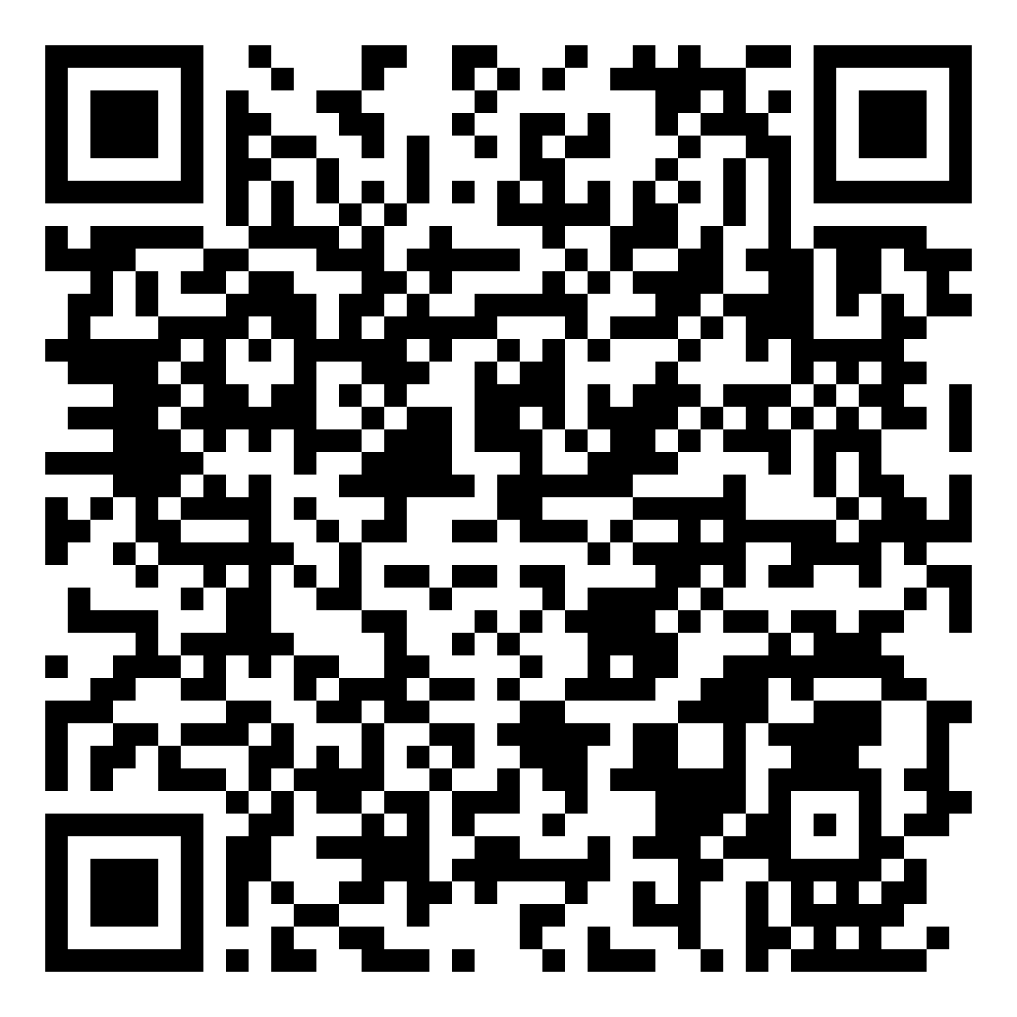
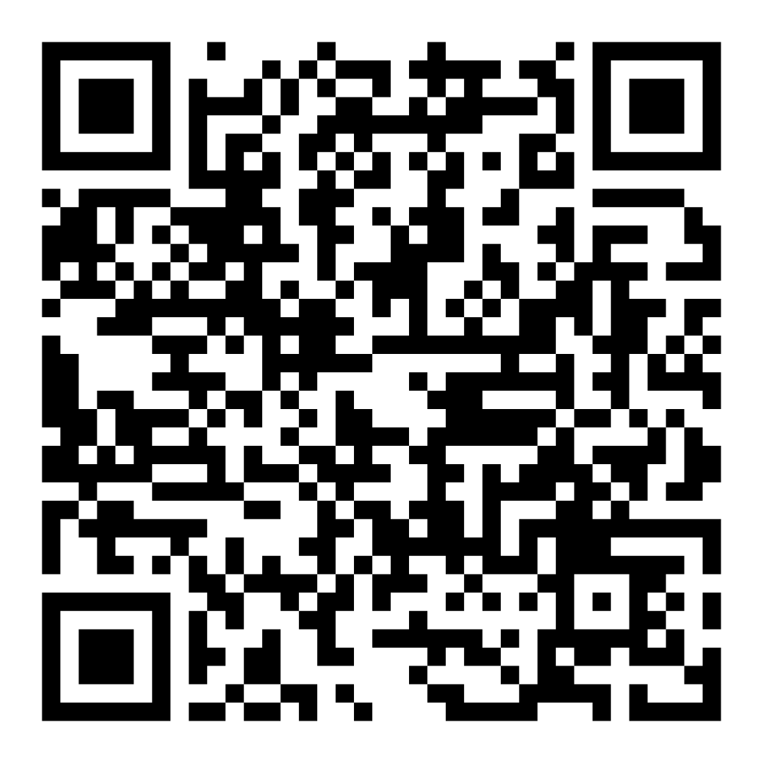
Pre-Health at UCLA
https://prehealth.ucla.edu/
"Pre-Health" refers to a pathway that prepares students for careers in healthcare professions (i.e. medicine, nursing, physician assistant, optometry, pharmacy, dental, physical therapy, or veterinary fields).
Pre-Health
Requirements Worksheet
UCLA Pre-Health
Services

Slide 14
Medical School Requirements
3 quarters of college English (AP coursework does not apply)
3 quarters of college Math, including Statistics (AP coursework does not apply)
1 year of Biology with lab (LIFESCI 7A, 7B, 7C, 7L)
CHEM 14 series or CHEM 20/30 series + CHEM 153A fulfills the Chemistry with lab requirement (AP does not apply)
1 year of Physics with lab (PHYSICS 5A, 5B, 5C)
Spanish is highly recommended

Slide 15
Fall Quarter Recommendations
3 Courses Total:
No more than 2 Life Sciences Core/ Major preparation classes
Any combination of Life Sciences (7A), Chemistry, & Math (30A). Examples:
LIFESCI 7A & LIFESCI 30A
CHEM 14A & LIFESCI 30A
1 non-major class (ex: Cluster, ENG COMP 3 course, GE course)

Slide 16
Getting Involved in Undergraduate Research
Biomedical Research Minor
Introductory course required to apply - BMD RES 5HA, BMD RES 10H, HNRS 70A
Undergraduate Research Center - Sciences
Consult with your major advisor for major-specific information.

Slide 17
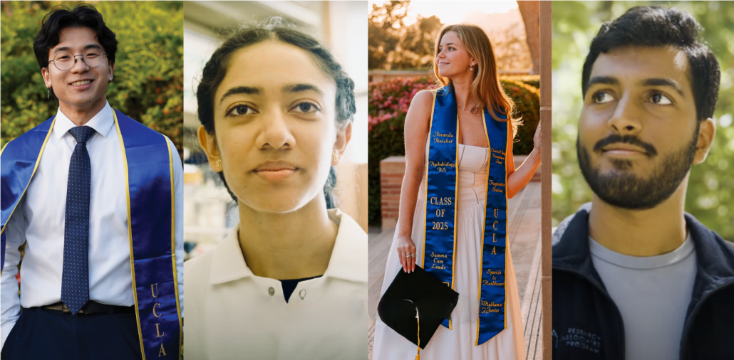
Thank You! Questions?

Slide 18
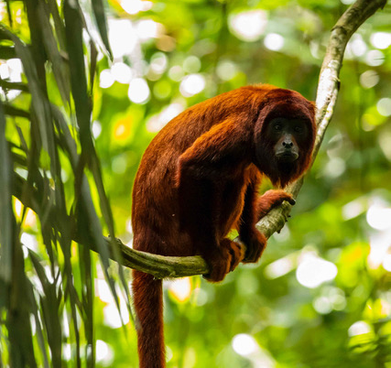
Ecology and Evolutionary Biology
EEB offers three (3) different majors:
Biology
Ecology, Behavior, and Evolution (EBE)
Marine Biology
And two (2) minors :
Conservation Biology
Evolutionary Medicine
The focus of the EEB department is to explore the natural world, including the study of non-human behavior (animals and plants), biodiversity, ecology, conservation biology, evolution (including evolutionary medicine), marine biology, plant biology, paleobiology, physiology, and tropical biology, among other areas of interest. Although the EEB majors do not focus on human biology or physiology, many of our students pursue careers in the health sciences, including medicine, dentistry, pharmacy, veterinary medicine, and all other career paths.

Slide 19
Computational Biology (Formerly Known as Computational and Systems Biology)
Main way to communicate with Comp Bio Advisor is Message Center
Key Differences compared to other LS Majors:
Student must take Fundamental COM SCI course in Major Prep(COM SCI 31 or PIC 10A)
STATS 10 is required for our major
Some Med School requirements not required for CaSB. Students must plan accordingly
Only accepts AP credit for MATH 31A and MATH 31B.
Research focused major – Capstone(Research) requirement
Notes:
Comp Bio is an Interdepartmental Program that’s primary goal is to prepare students for high level research within any Life Science major research lab. Comp Bio’s major prep and UD core can feel very sporadic, and this is intended. The purpose of courses within Comp Bio is to give students fundamental skills to succeed in a variety of research labs. The earlier a student begins with research, the more they can specialize their course plan to pair well with their research. This leads to students becoming mini research experts in a specific field. If this sounds interesting to you, it is highly recommended that you speak with the Comp Bio Academic Advisor as soon as possible to learn more about the major.

Slide 20
Integrative Biology and Physiology
Are you interested in pursuing an education and career in medicine or one of the other health professions such as physical therapy, optometry, pharmacology, or dentistry among others, or perhaps industrial biotechnology or biomedical research is your passion? Are you interested in a career in one of the fields of public health or health science teaching? Or are you simply curious about how the human body functions and wonder where the educational preparation we offer can take you?
Physiological Science is the only major and academic discipline which provides an education that spans levels of biological organization from genes and gene networks, to molecular mechanisms of cell function, to cell and tissue organization and function, and to whole system level physiology.

Slide 21
Learn More about Life Sciences Majors at UCLA

Slide 22
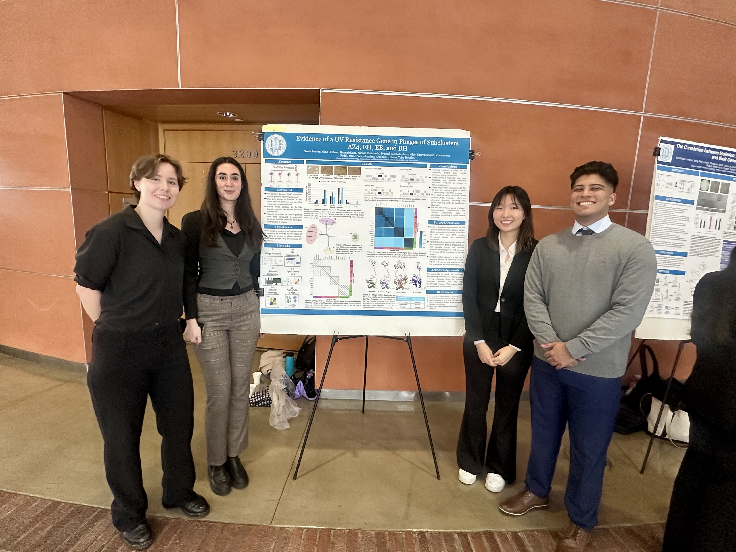
Microbiology, Immunology, & Molecular Genetics (MIMG)
The MIMG major combines cutting-edge biological science with hands-on research experience. Students engage in authentic research practices to develop and refine critical skills, preparing them to address pressing global challenges such as infectious diseases, cancer, climate change, & food security.

Slide 23
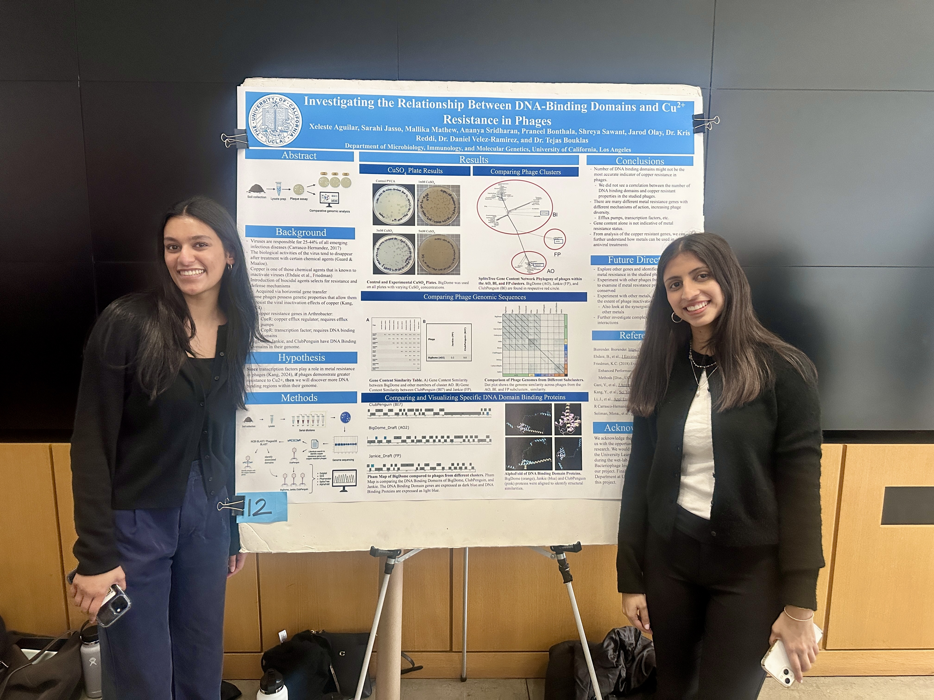
MIMG Academic Highlights
Authentic research experience guaranteed through Path 1
research immersion courses (2 qtrs. of research required).
Focus on infectious diseases & immune responses, study of bacterial & viral mechanisms, & the integration of molecular genetics with microbiological systems.
Diverse specialization options through the major with electives covering fields including cell & gene therapy, virology, parasitology, genomics, microscopy, human genetics, & quantitative regulatory biology.

Slide 24
Molecular, Cell & Developmental Biology
MCDB is the study of life on earth at the cellular and molecular levels.
Emphasis on research
MCDB classes taught using primary literature (scientific papers)!
Curriculum updated annually to reflect scientific advances in the field
All MCDB majors participate in authentic, discovery-based lab experience

Slide 25
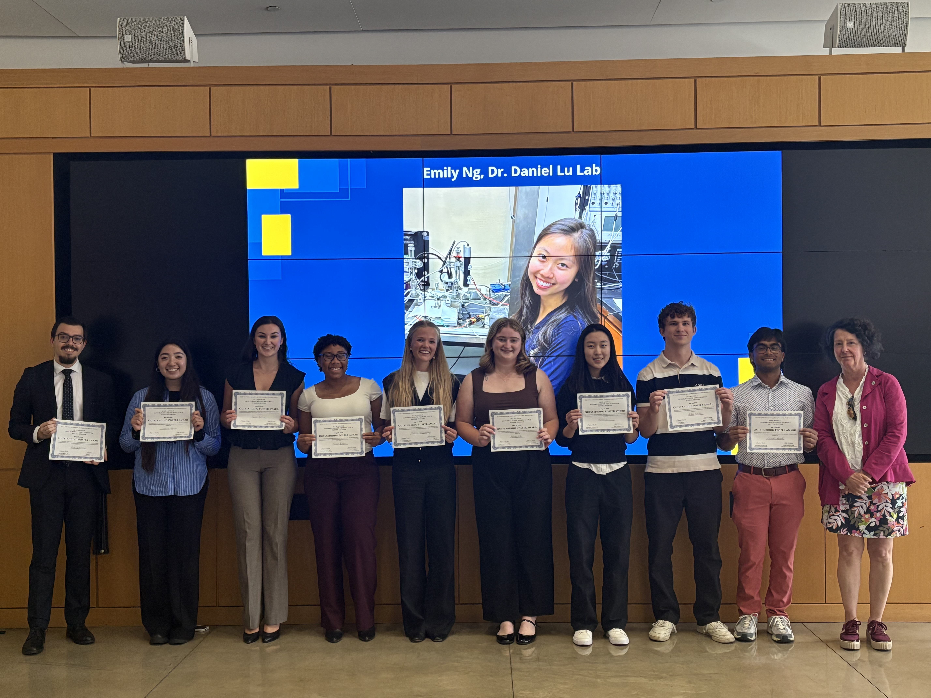
Neuroscience Interdepartmental Program
Neuroscience is the scientific study of the brain and nervous system, whose ultimate goal is to understand higher brain function at a variety of levels.
The program is interdepartmental so all of our faculty volunteer to teach in our program. Students are also able to take upper division electives from different departments like Psychology, Physiological Science etc.
The Neuroscience major is a capstone major! Students will complete a two-quarter project either through taking classes, conducting independent research, or participating in our public outreach capstone options. Most students will complete this in their senior year.

Slide 26
Neuroscience Interdepartmental Program
The Neuroscience program is very structured as there is a core series all students must take known as NEUROSC M101A, M101B, and M101C. These courses are only offered once a year and students will typically take them in their third year.
The prerequisites needed to start the Neuroscience core series are:
LS 30A, 30B OR MATH 3A, 3B, 3C OR MATH 31A, 31B,32A
LS 7A, 7B, 7C
CHEM 14A, 14B, 14C OR CHEM 20A, 20B, 30A
PHYSICS 5A and PHYSICS 5C
Students who are not able to complete these major prep courses by fall of their third year will complete a “flipped schedule”. This involves completing the Neuroscience core series in your senior year. Please ensure to meet with an advisor to discuss this option.

Slide 27
UCLA Division of Life Sciences Interdepartmental Programs
Departments | Majors Offered | Minors Offered
Computational Biology | Computational Biology, B.S. | Mathematical Biology Structural Biology Systems Biology
Ecology and Evolutionary Biology | Biology, B.S. Ecology Behavior and Evolution, B.S. Marine Biology, B.S. | Conservation Biology Evolutionary Medicine
Integrative Biology and Physiology | Physiological Science, B.S. | N/A

Slide 28
UCLA Division of Life Sciences Interdepartmental Programs
Departments | Majors Offered | Minors Offered
Microbiology, Immunology, and Molecular Genetics | Microbiology, Immunology, and Molecular Genetics, B.S. | N/A
Molecular, Cell, and Developmental Biology | Molecular, Cell and Developmental Biology, B.S. | N/A
Psychology | Cognitive Science, B.S. Psychobiology, B.S. Psychology, B.S. | Applied Developmental Psychology

Slide 29
UCLA Division of Life Sciences Interdepartmental Programs
Program | Majors Offered | Minors Offered
Biomedical Research | N/A | Biomedical Research
Institute for Society and Genetics | Human Biology and Society, B.A. Human Biology and Society, B.S. | Society and Genetics
Neuroscience Interdepartmental Program | Neuroscience, B.S. | Neuroscience

Slide 30
Life Sciences Majors at UCLA
Major | Advisor(s) | Contact
Biology | Eileen Mansoorian; Jessica Angus; Wendy Ramos | Message Center
Cognitive Science | Jaclyn Robbin; Audrey Dowling; Jessica Helfond; Ajah Whitehead | Message Center
Computational Biology | Brian Flores | Message Center
Ecology, Behavior and Evolution | Eileen Mansoorian; Jessica Angus; Wendy Ramos | Message Center

Slide 31
Life Sciences Majors at UCLA (continued)
Major | Advisor(s) | Contact
Human Biology and Society (B.A., B.S.) | Frenz Cabison; Elena Allen | ISGAcademics@ucla.edu
Physiological Science | Inna Gergel | Gergel@physci.ucla.edu
Marine Biology | Eileen Mansoorian; Jessica Angus; Wendy Ramos | Message Center

Slide 32
Life Sciences Majors at UCLA (continued)
Major | Advisor(s) | Contact
Microbiology, Immunology & Molecular Genetics | Dr. Fonseca; Sierra Dwyer | undergrad@ microbio.ucla.edu
Molecular, Cell and Developmental Biology | Maggie Schmall; Jason Giron | Undergradmcdb@lifesci.ucla.edu
Neuroscience | Aftin Whitten; Louis Perez | Neurosci@ucla.edu

Slide 33
Life Sciences Majors at UCLA (continued)
Major | Advisor(s) | Contact
Psychobiology | Jaclyn Robbin; Audrey Dowling; Jessica Helfond; Ajah Whitehead | Message Center
Psychology (B.A.) | Jaclyn Robbin; Audrey Dowling; Jessica Helfond; Ajah Whitehead | Message Center

Slide 34
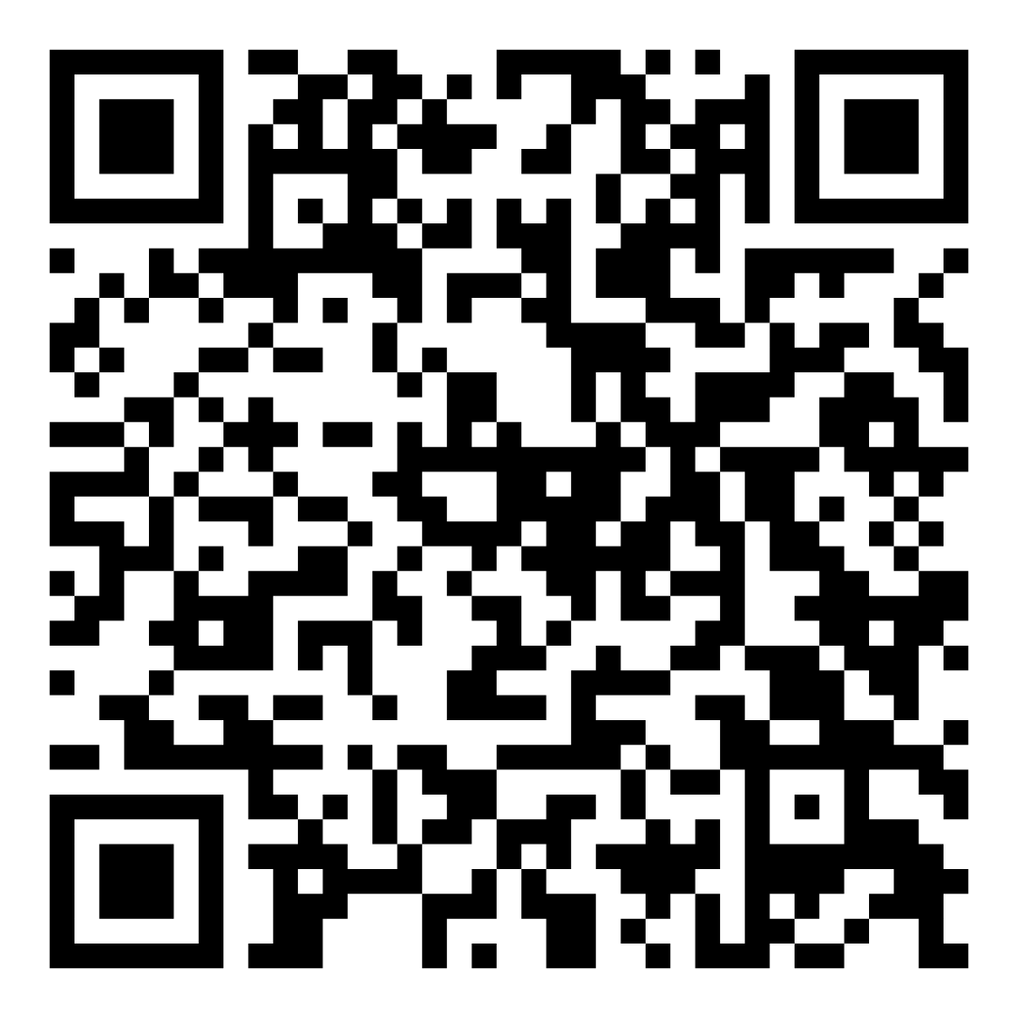
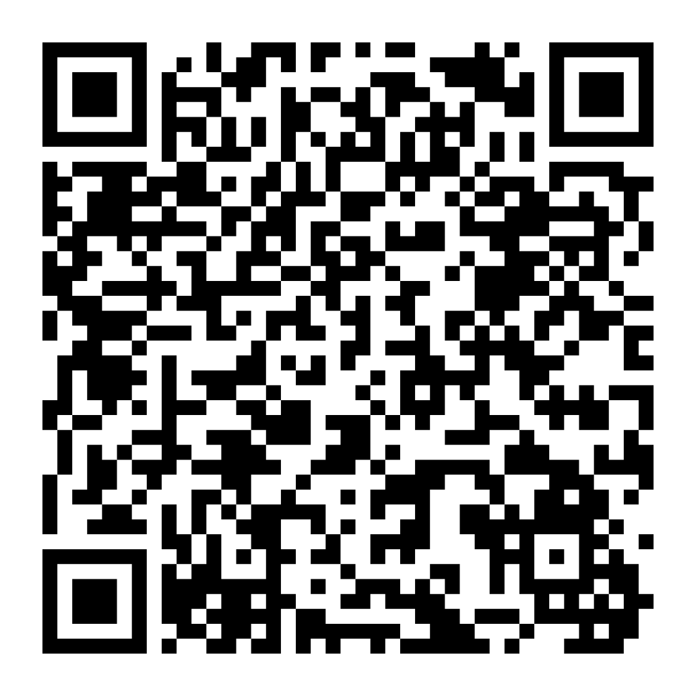
Resources
Copy of Presentation
UCLA Departmental/
Major Advisor Contact List

